Slide 1


Slide 2

CHAPTER-3
BLOCK CIPHERS AND THE DATAENCRYPTION STANDARD

Slide 3
Contents
Syllabus
Stream Ciphers and block ciphers
Block cipher principles
Data stream ciphers
Confuison & Diffusion
Data Encryption Standard(DES)
Deferential and linear cryptanalysis
Avalanche Effect
Strength of DES
Design principles of block cipher

Slide 4
Stream Cipher
A stream cipher is a symmetric key cipher where plaintext digits are combined with a pseudorandom cipher digit stream (keystream). Each plaintext digit is encrypted one at a time with the corresponding digit of the keystream.
Key Characteristics:
Symmetric Encryption: Uses the same key for both encryption and decryption.
Bit-by-Bit Operation: Encrypts plaintext data one bit or byte at a time.
Pseudorandom Keystream: Generates a keystream based on an initial seed value or key.

Slide 5
Stream Cipher- Example
Key(k_{i}) 010101
Bit-stream
Generation algorithm
Key(k_{i}) 010101
Bit-stream
Generation algorithm
K_{i}
⊕
ENCRYPTION
K_{i}
⊕
DECRYPTION
Plaintext(p_{i}) 100101
Ciphertext(c_{i}) 110000
Plaintext(p_{i}) 100101
5

Slide 6
Block Cipher
A block size of 64 or 128 bits is used.
Symmetric encryption
Confusion: Key to ciphertext relationship shoud be very complicated.
Diffusion: Output should depend on the input in a complex way.
Examples:
Feistel cipher, DES, Triple DES,AES etc.

Slide 7
Block Cipher- Example
b bits
b bits
Plaintext
Ciphertext
Key (K)
Encryption Algorithm
Key (K)
Decryption Algorithm
Ciphertext
Plaintext
b bits
7
b bits

Slide 8
Data Stream Cipher
A data stream cipher is a type of encryption algorithm that encrypts data one bit or byte at a time, rather than in fixed-size blocks. It uses a pseudorandom keystream which is combined with the plaintext to produce ciphertext.
Key Characteristics:
Symmetric Encryption: The same key is used for both encryption and decryption.
Continuous Data Flow: Suitable for encrypting data streams (e.g., audio, video).
Keystream Generation: The keystream is generated based on an initial seed value or key, ensuring the encryption process is secure as long as the key is kept secret.

Slide 9
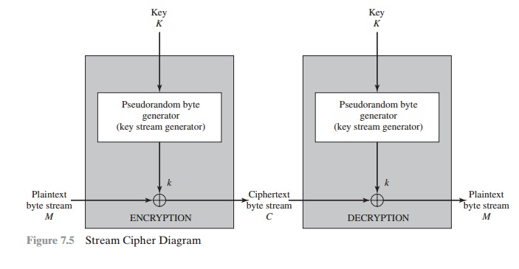
Data Stream Cipher- Example

Slide 10
Diffusion and Confusion
The terms diffusion and confusion were introduced by claude Shannon.
Shannon’s concern was to prevent cryptanalysis based onl analysis.
“Diffusion” = the statistical structure of the plaintext is dissipated into long-range statistics of the cipher text.
This is achieved by having each plaintext digit affect the value of many cipher text digits;
The mechanism of diffusion look for to make the statistical relationship between the plaintext and cipher text as complex as possible in order to prevent attempts to deduce the key.

Slide 11
Diffusion and Confusion
“Confusion” = confusion seeks to make the relationship between the statistics of the cipher text and the value of the encryption key as complex as possible, again to thwart attempts to discover the key.
Thus, even if the attacker can get some handle on the statistics of the cipher text, the way in which the key was used to produce that cipher text is so complex as to make it difficult to deduce the key.
This is achieved by the use of a complex substitution algorithm.

Slide 12
DES- Data Encryption Standard
The Data Encryption Standard (DES) is a symmetric-key block cipher published by the National Institute of Standards and Technology (NIST).
In 1973, NIST published a request for proposals for a national symmetric-key cryptosystem.
A proposal from IBM, a modification of a project called Lucifer, was accepted as DES.
DES was published in the Federal Register in March 1975 as a draft of the Federal Information Processing Standard (FIPS).

Slide 13
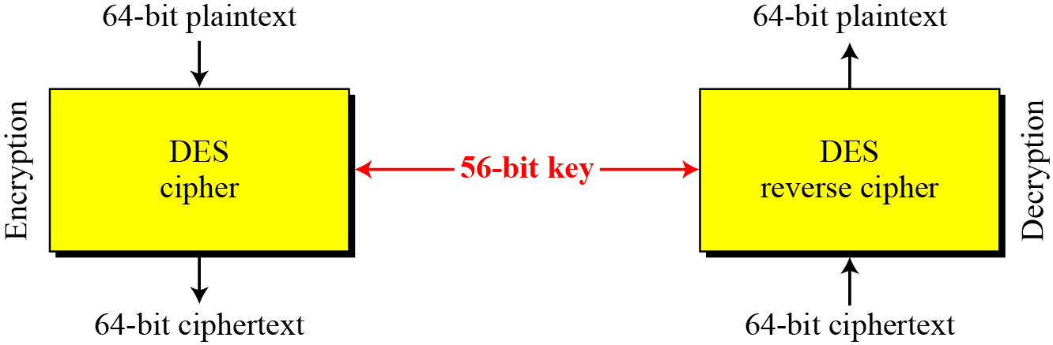
DES- Data Encryption Standard
Type: DES is a block cipher
Block Size : 64-bit
Key Size: 64-bit, with only 56-bit effective
Number of Rounds: 16

Slide 14
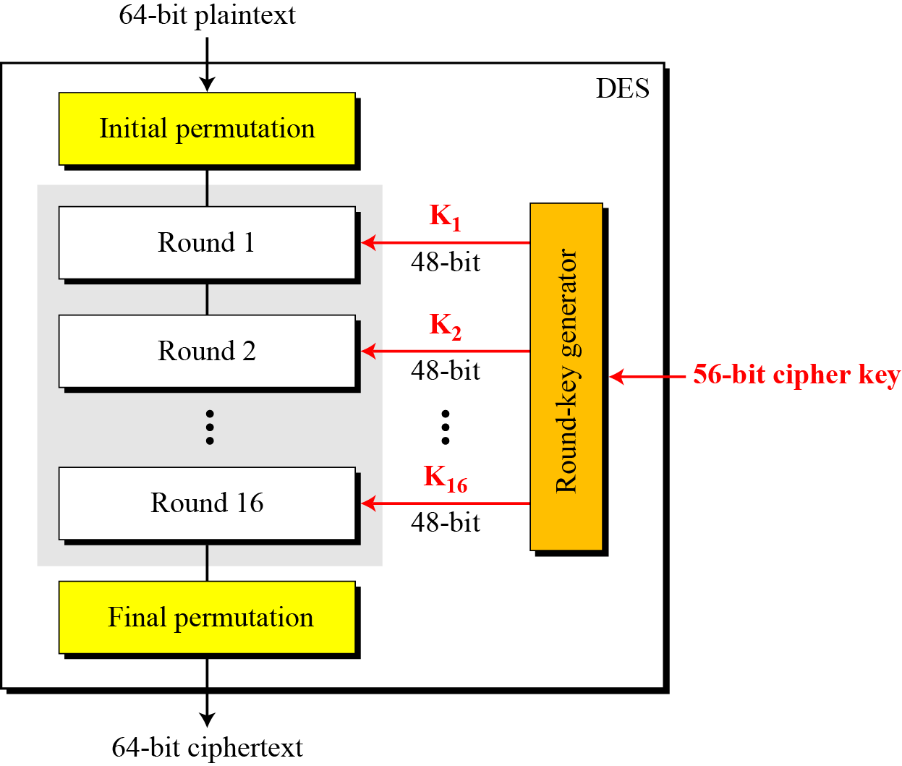
DES STRUCTURE
The encryption process is made of two permutations (P-boxes), which we call initial and final permutations, and sixteen Feistel rounds.

Slide 15
DES Encryption Algorithm
64-bit plaintext
64-bit key
Initial Permutation
Permuted choice 1
64
56
Round 1
K₁
48
Permuted choice 2
56
Left circular shift
64
K₂
48
56
64-bit key
56
Round 2
Permuted choice 2
^{K}16
48
56
56
Round 16
Permuted choice 2
Left circular shift
32-bit swap
64
Inverse Initial Permutation
64-bit Cipher text

Slide 16
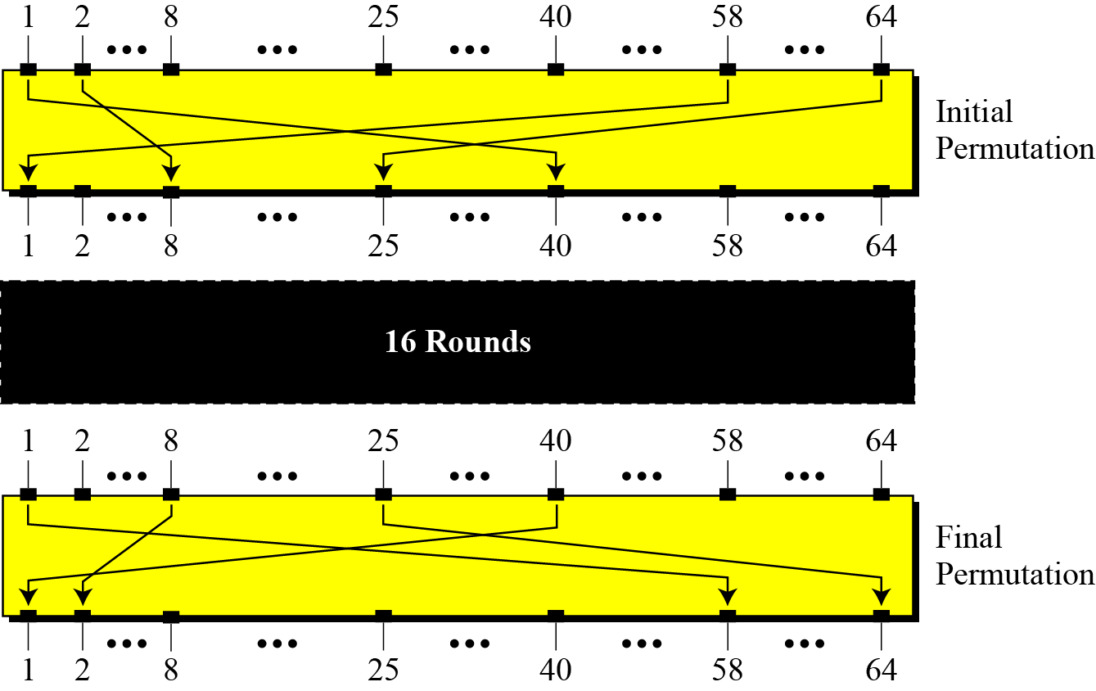
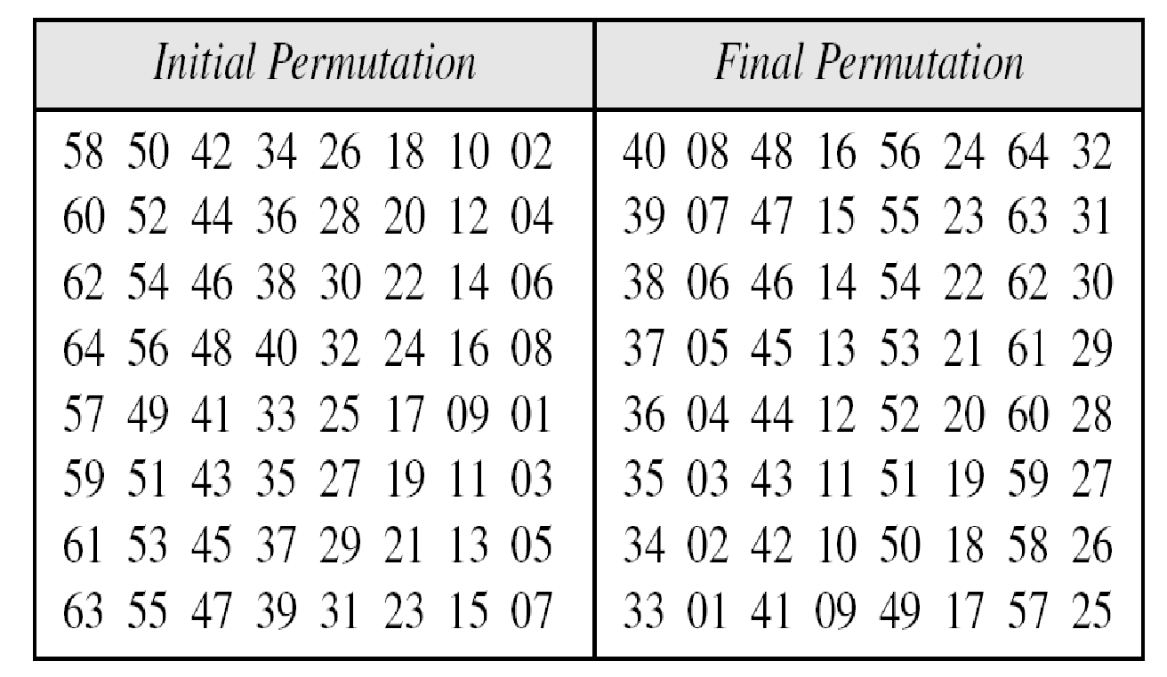
Initial and Final Permutations in DES

Slide 17
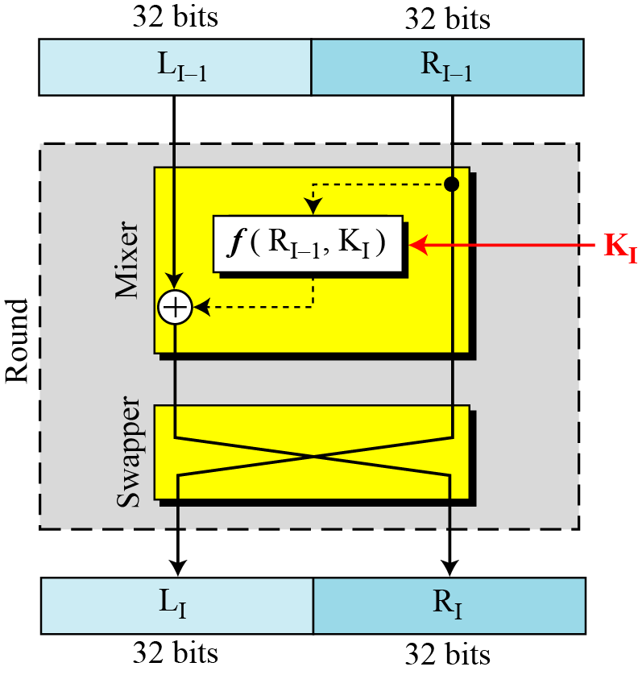
DES uses 16 rounds. Each round of DES is a Feistel cipher.

Slide 18
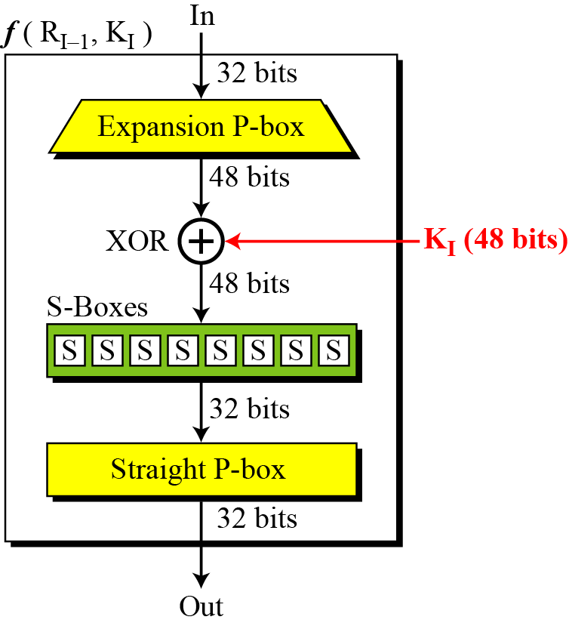
DES Function
The heart of DES is the DES function. The DES function applies a 48-bit key to the rightmost 32 bits to produce a 32-bit output.

Slide 19
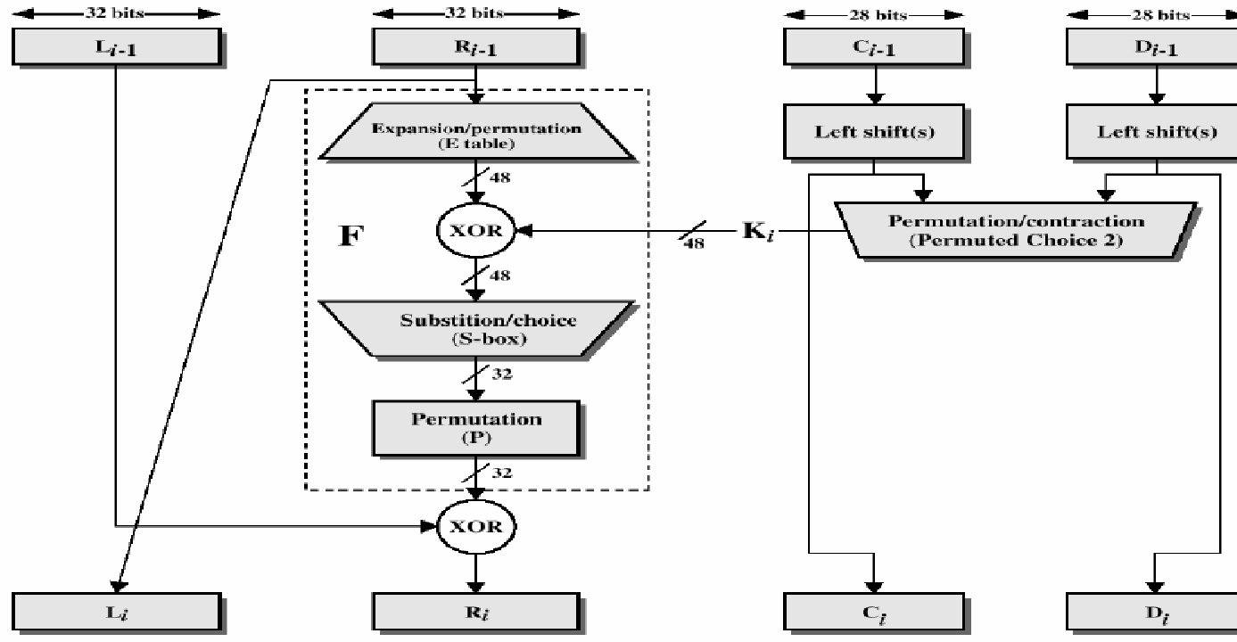
Details of Single Round of DES Algorithm

Slide 20
DES Single Round (Cont…)
Key Transformation
Permutation of selection of sub-key from original key
Expansion Permutation (E-table)
Right half is expanded from 32-bits to 48-bits
S-box Substitution
Accepts 48-bits from XOR operation and produce 32-bits using 8 substitution boxes (each S-boxes has a 6-bit i/p and 4-bit o/p).
P-Box Permutation
XOR and Swap

Slide 21
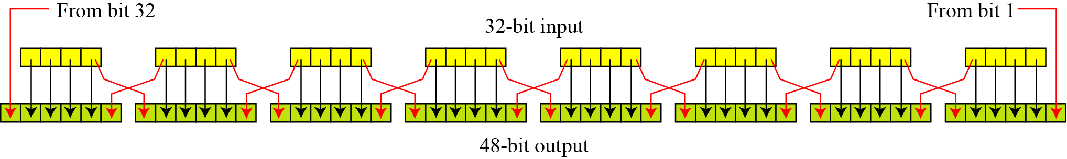
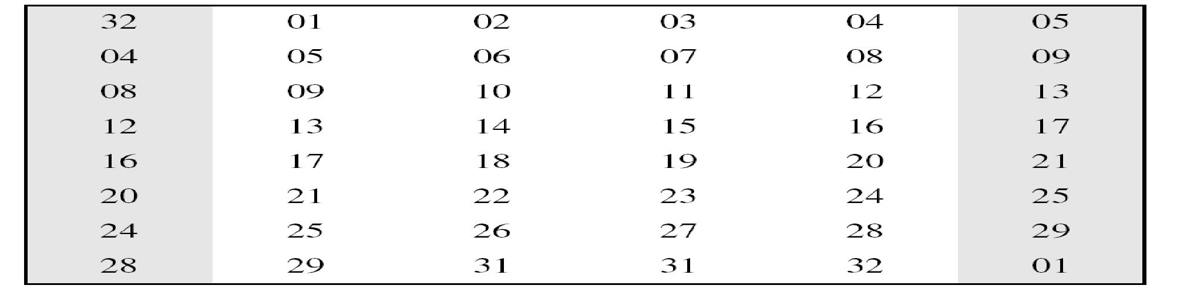
Expansion permutation
Expansion P-box –E(R):Since RI−1 is a 32-bit input and KI is a 48-bit key, we first need to expand RI−1 to 48 bits.

Slide 22
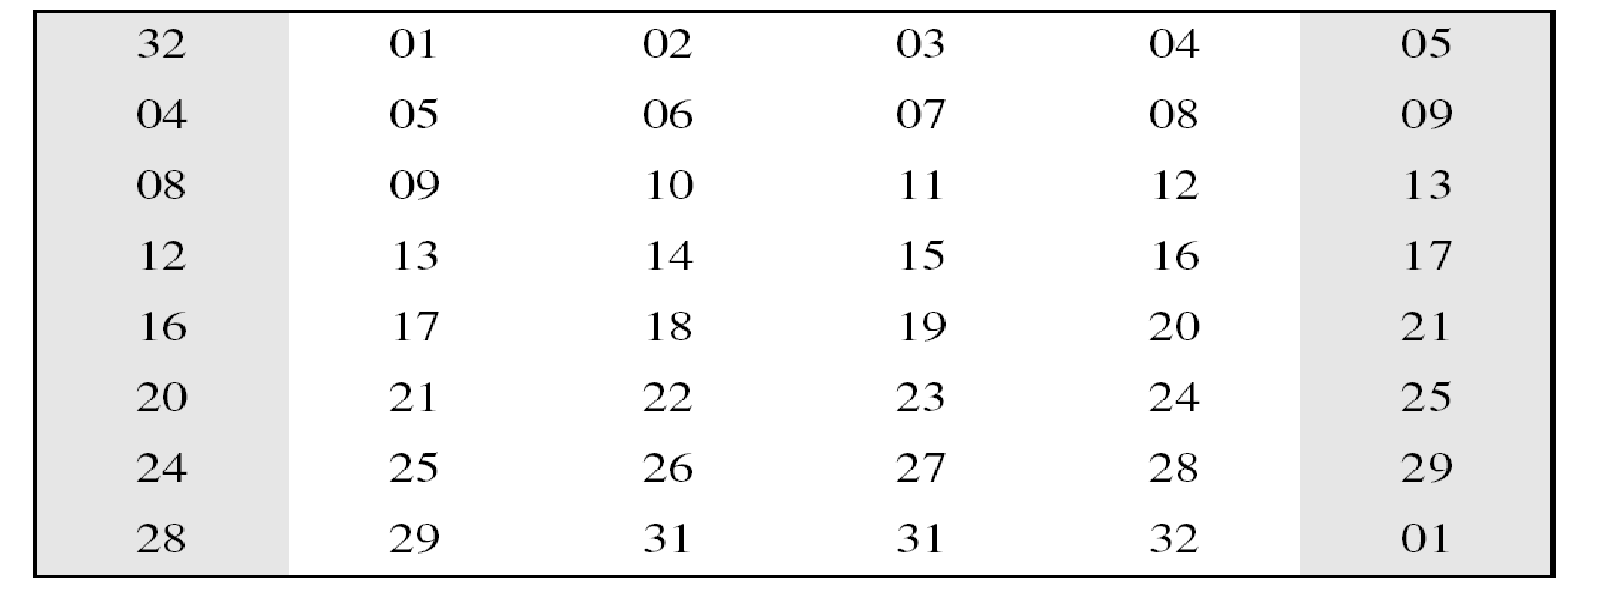
Expansion P-box table
Although the relationship between the input and output can be defined mathematically, DES uses Table 2 to define this P-box.

Slide 23
Block Cipher Components
P Box
key less fixed transposition cipher.
used to provide diffusion
Input bits are permuted to produce output bits
Classifies in three types:

Slide 24
Whitener (XOR)
After the expansion permutation, DES uses the XOR operation on the expanded right section and the round key. Note that both the right section and the key are 48-bits in length. Also note that the round key is used only in this operation.

Slide 25
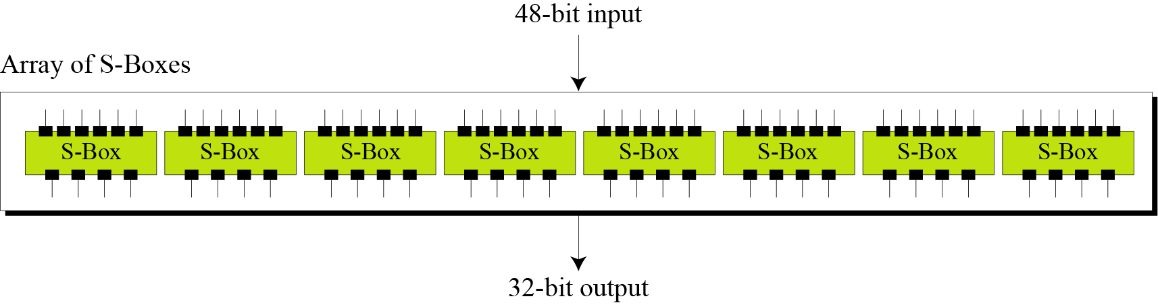
S-Boxes
The S-boxes do the real mixing (confusion). DES uses 8 S-boxes, each with a 6-bit input and a 4-bit output.

Slide 26
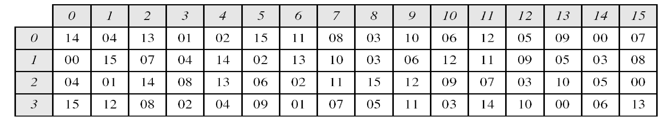
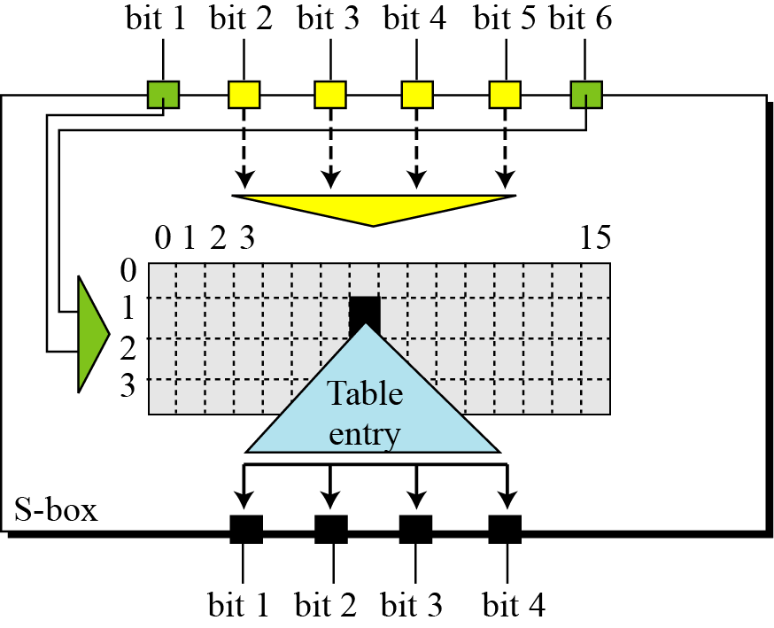
S-Boxes( Continue)
Table shows the permutation for S-box 1. For the rest of the boxes see the textbook.

Slide 27
Block Cipher Components
S Box
key less fixed substitution cipher.
used to provide confusion
dependent on unknown key
take n bit of plaintext as a input and produce m bit of cipher text as output, where value of n & m may be same or different
mapping is predetermined

Slide 28
Example-1
The input to S-box 1 is 100011. What is the output?
Solution: If we write the first and the sixth bits together, we get 11 in binary, which is 3 in decimal. The remaining bits are 0001 in binary, which is 1 in decimal. We look for the value in row 3, column 1, in Table 6.3 (S-box 1). The result is 12 in decimal, which in binary is 1100. So the input 100011 yields the output 1100.

Slide 29
Example-2
The input to S-box 8 is 000000. What is the output?
Solution: If we write the first and the sixth bits together, we get 00 in binary, which is 0 in decimal. The remaining bits are 0000 in binary, which is 0 in decimal. We look for the value in row 0, column 0, in Table 6.10 (S-box 8). The result is 13 in decimal, which is 1101 in binary. So the input 000000 yields the output 1101.

Slide 30
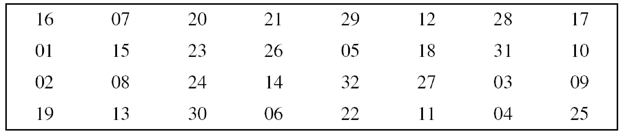
Straight Permutation
Straight P box
takes n bits as i/p permutes n bits as o/p
so n! of ways to map i/p to o/p

Slide 31
Cipher and Reverse Cipher
Using mixers and swappers, we can create the cipher and reverse cipher, each having 16 rounds.
First Approach
To achieve this goal, one approach is to make the last round (round 16) different from the others; it has only a mixer and no swapper.
Note: In the first approach, there is no swapper in the last round.

Slide 32
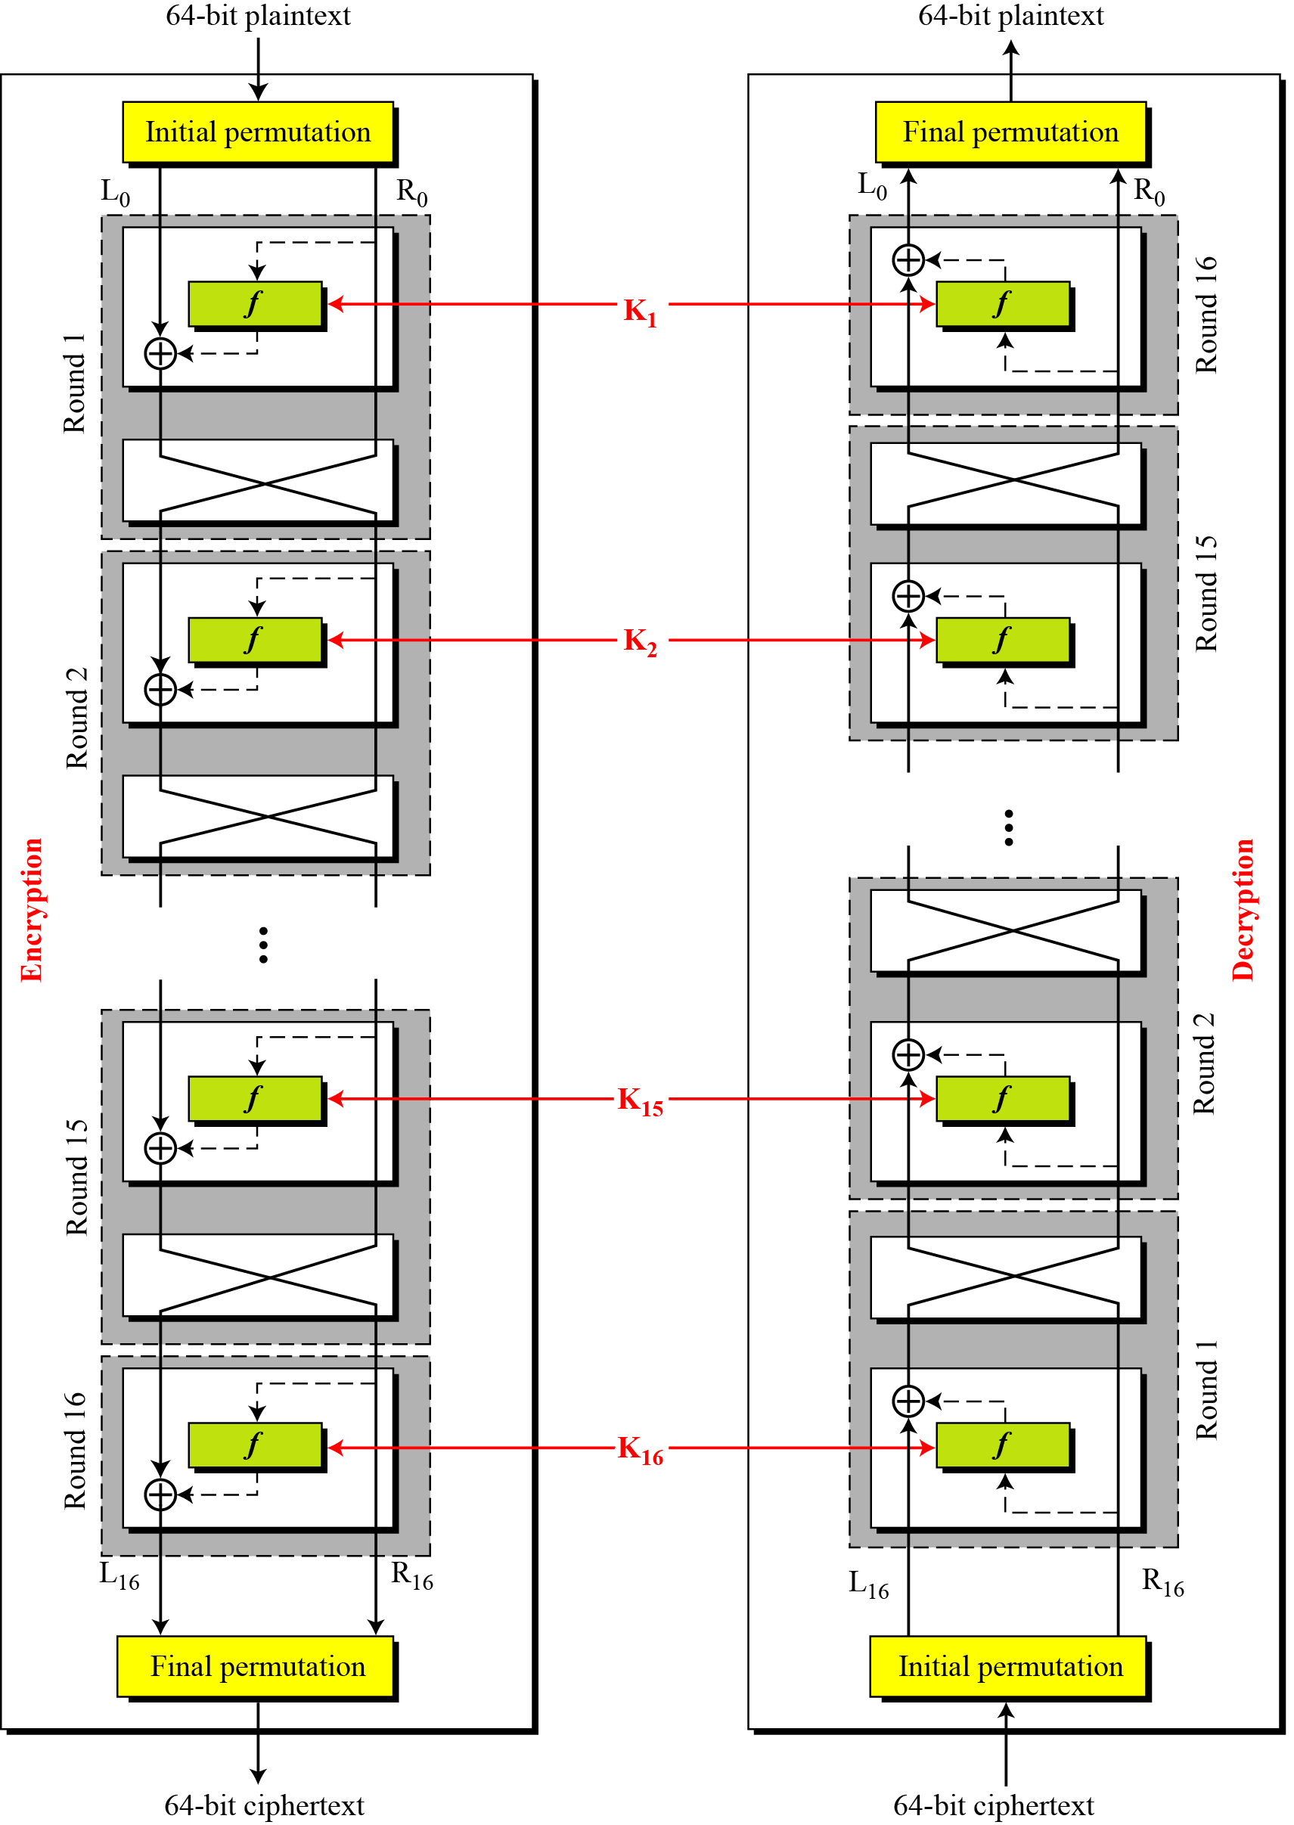
DES cipher and reverse cipher for the first approach

Slide 33
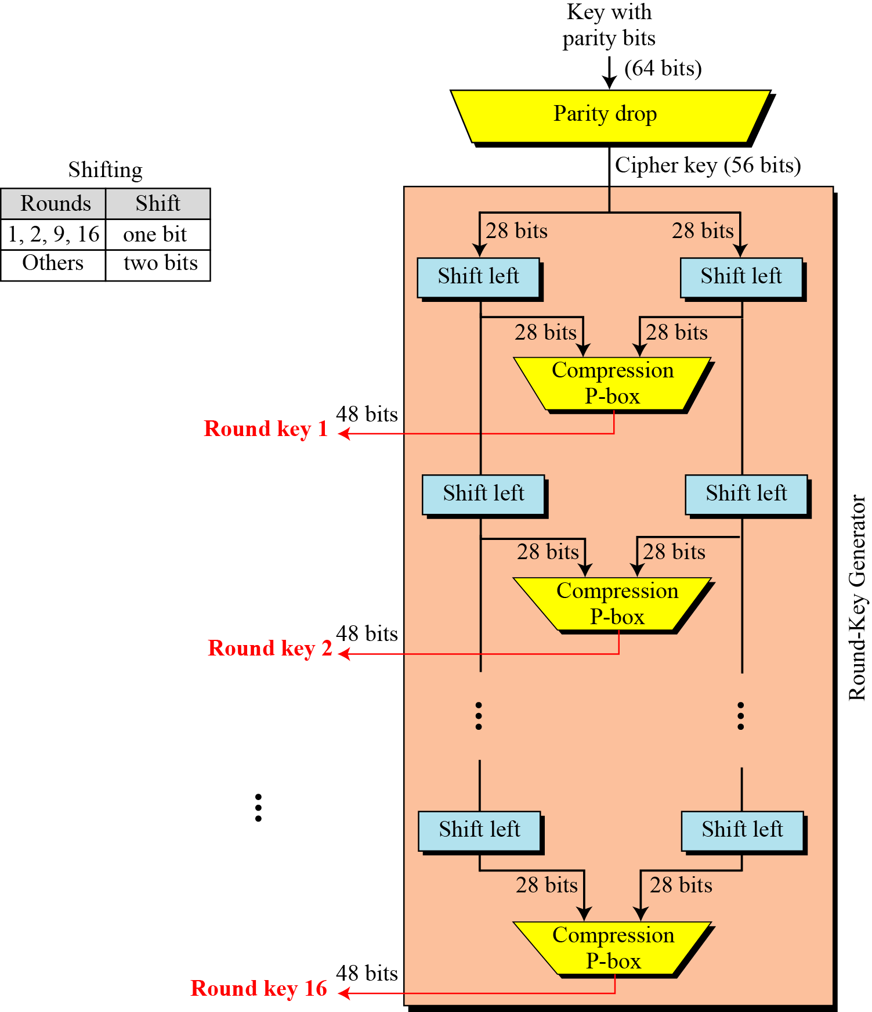
Key Generation
The round-key generator creates sixteen 48-bit keys out of a 56-bit cipher key.

Slide 34
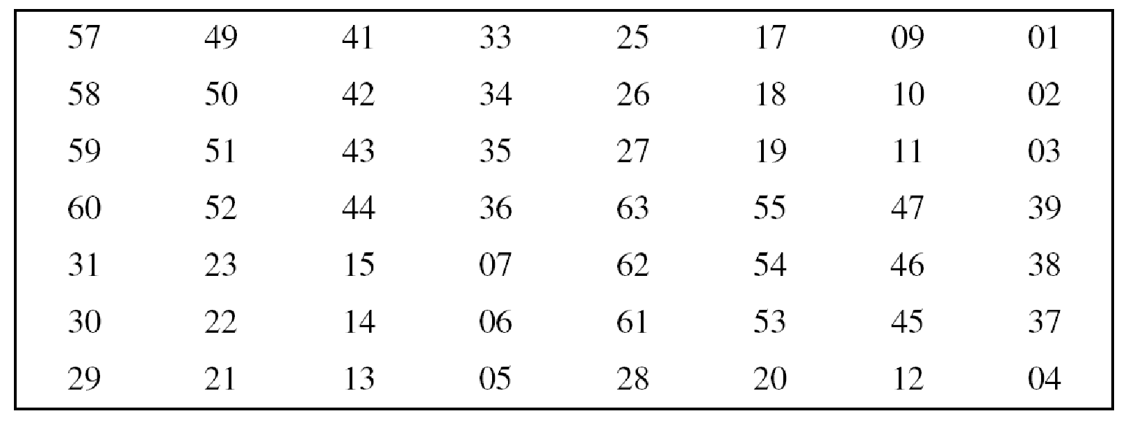
Parity-bit drop table PC-1

Slide 35
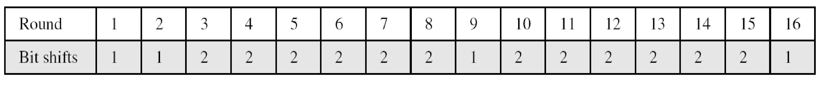
Block Cipher Components
Circular shift
Classifies in two ways:
Circular left shift
every bit of word is shifted by specific number of positions in left direction
n number of leftmost bits are removed and placed at rightmost
Number of bits shifts

Slide 36
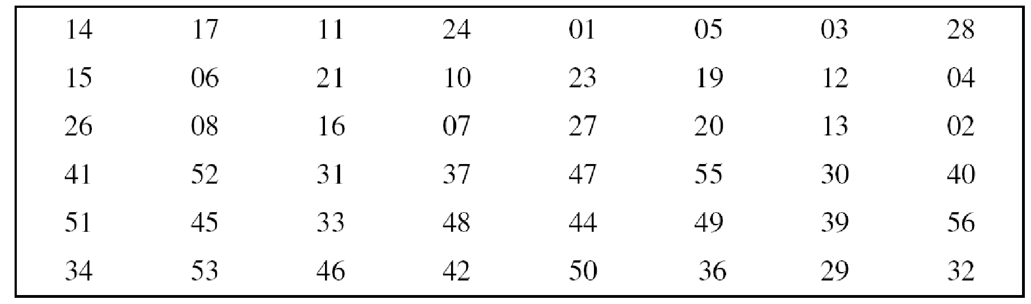
Key-compression table (PC-2)

Slide 37
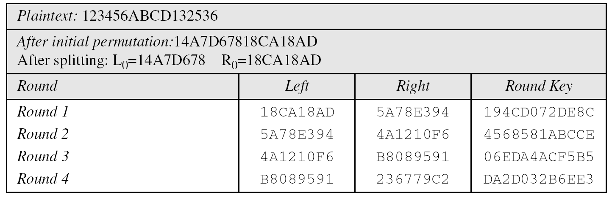
Example-3
We choose a random plaintext block and a random key, and determine what the ciphertext block would be (all in hexadecimal):

Slide 38
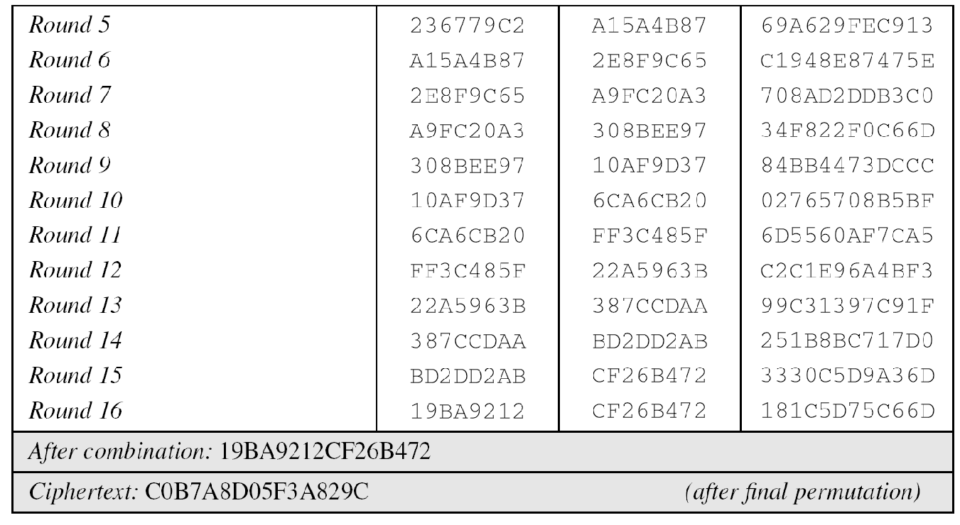
Example-3(Continue)

Slide 39
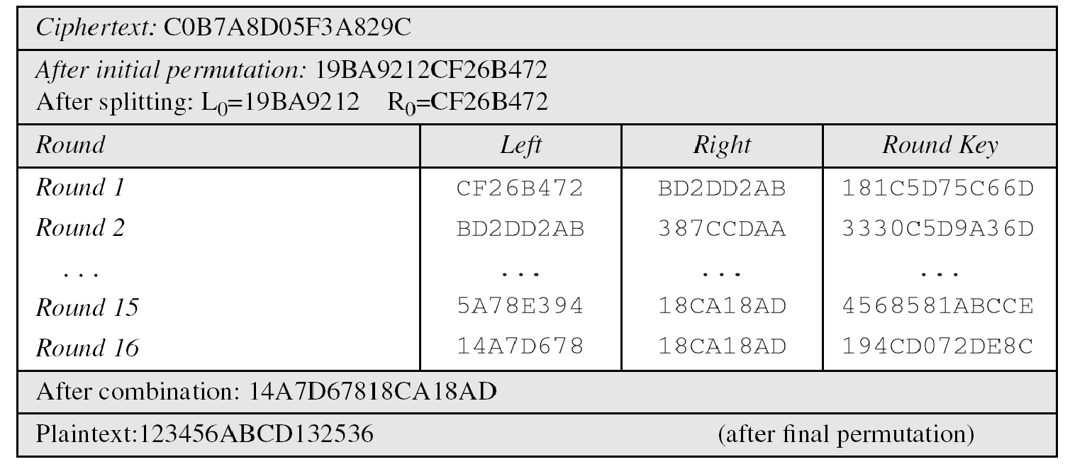
Example-4
Let us see how Bob, at the destination, can decipher the ciphertext received from Alice using the same key. Table 6.16 shows some interesting points.

Slide 40
DES ANALYSIS
Critics have used a strong magnifier to analyze DES. Tests have been done to measure the strength of some desired properties in a block cipher.
Topics discussed in this section:
Properties
Design Criteria
DES Weaknesses

Slide 41
Properties
Two desired properties of a block cipher are the avalanche effect and the completeness.

Slide 42
The Avalanche Effect
A desirable property of any encryption algorithm is that a small change in either the plaintext or the key should produce significant change in the ciphertext – avalanche effect.
In particular, a change in one bit of the plaintext or one bit of the key should produce a change in many bits of the ciphertext.

Slide 43
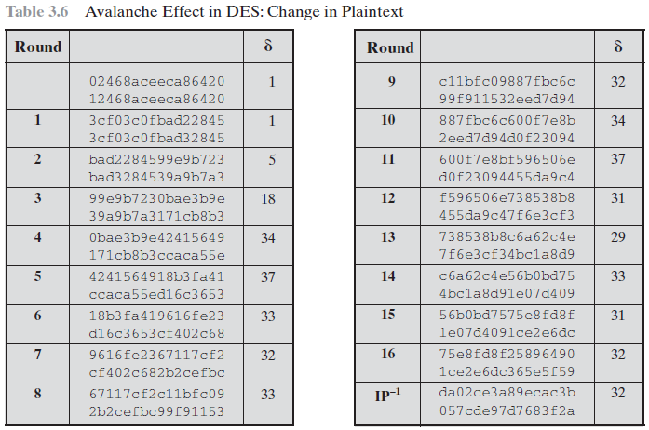
The Avalanche Effect

Slide 44
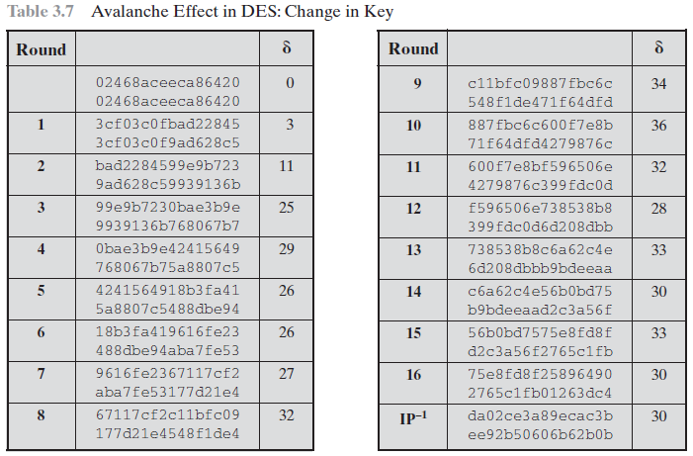
The Avalanche Effect

Slide 45
Completeness effect
Completeness effect means that each bit of the ciphertext needs to depend on many bits on the plaintext.

Slide 46
Design Criteria
S-Boxe:
The design provides confusion and diffusion of bits from each round to the next.
P-Boxes:
They provide diffusion of bits.
Number of Rounds:
DES uses sixteen rounds of Feistel ciphers. the ciphertext is thoroughly a random function of plaintext and ciphertext.

Slide 47
DES Weaknesses
During the last few years critics have found some weaknesses in DES.
Weaknesses in Cipher Design
1. Weaknesses in S-boxes
2. Weaknesses in P-boxes
3. Weaknesses in Key

Slide 48
Security of DES
DES, as the first important block cipher, has gone through much scrutiny. Among the attempted attacks, three are of interest: brute-force, differential cryptanalysis, and linear cryptanalysis.
Topics discussed in this section:
Brute-Force Attack Differential Cryptanalysis
Linear Cryptanalysis

Slide 49
Brute-Force Attack
We have discussed the weakness of short cipher key in DES. Combining this weakness with the key complement weakness, it is clear that DES can be broken using 255 encryptions.

Slide 50
Differential Cryptanalysis
It has been revealed that the designers of DES already knew about this type of attack and designed S-boxes and chose 16 as the number of rounds to make DES specifically resistant to this type of attack.

Slide 51
Linear Cryptanalysis
Linear cryptanalysis is newer than differential cryptanalysis. DES is more vulnerable to linear cryptanalysis than to differential cryptanalysis. S-boxes are not very resistant to linear cryptanalysis. It has been shown that DES can be broken using 243 pairs of known plaintexts. However, from the practical point of view, finding so many pairs is very unlikely.

Slide 52
The Strength of DES
The use of 56-bit keys
With the key length of 56 bits, there are 256 possible keys, which is approximately 7.2x1016 keys. Thus, on the face of it, brute-force attack appears impractical.
DES finally and definitively proved insecure in july 1998, when the Electronic Frontier Foundation (EFF) announced that it had broken a DES encryption using a special-purpose “DES Crackers” machine that was built for less than $250000.
Fortunately, there are a number of alternatives to DES, the most important of which are AES and triple DES

Slide 53
The Strength of DES (Conti…)
The nature of the DES Algorithm.
Another concern is the possibility that cryptanalysis is possible by exploiting the characteristics of the DES algorithm.
The focus of concern has been on the eight substitution tables, or S-boxes, that are used in each iteration.
Because the design criteria for these boxes, and indeed for the entire algorithm, were not made public, there is a mistrust that the boxes were constructed in such a way that cryptanalysis is possible for an adversary who knows the weakness in the S-boxes.
This statement is attracting and over the years a number of regularities and unexpected behaviors of the S-boxes have been discovered.
Even if this, no one has so far succeeded in discovering the supposed fatal weaknesses in the S-boxes.

Slide 54
The Strength of DES (Conti…)
Timing Attacks
Timing attack is one in which information about the key or the plaintext is obtained by observing how long it takes a given implementation to perform decryptions on various ciphertext.
A timing attack exploits the fact that an encryption or decryption algorithm often takes slightly different amounts of time on different inputs.
DES appears to be fairly resistant to a successful timing attack.

Slide 55
Block cipher design principles
DES design criteria
Focus on design of S box and P function
Number of rounds
The greater the number of rounds the more difficult it is to perform cryptanalysis, even for a relatively weak F.
Design of function F
Algorithm should have good avalanche property
Bit independence criterion (BIC) that states that output bits j and k should change independently when any single bit I is inverted.
Key schedule Algorithm
Select the subkeys to maximize the difficulty of deducing individual subkeys and the difficulty of working back to the main key.

Slide 56
Differential and Linear Cryptanalysis
Differential Cryptanalysis attack
It found in 1990.
It required 247 chosen plain text.
Differential cryptanalysis is the first published attack that is capable of breaking DES in less than 255 encryptions.
The idea behind differential cryptanalysis is to observe the behavior of pairs of text blocks evolving along each round of the cipher, instead of observing the evolution of a single text block.

Slide 57
Differential and Linear Cryptanalysis
Differential Cryptanalysis attack
Consider the original plaintext block m to consist of two halves m0,m1.
Each round of DES maps the right-hand input into the left-hand output and sets the right-hand output to be a function of the left-hand input and the subkey for this round. So, at each round, only one new 32-bit block is created.
If we label each new block mi (2 <= i<=17) then the intermediate message halves are related as follows:

Slide 58

Differential Cryptanalysis attack
In differential cryptanalysis, we start two messages, m and m’, with a known XOR difference ∆m=m XOR m’ and consider the difference between the intermediate message halves: ∆mi=mi XOR mi’ then we have.
Therefore, if we know and with high probability, then we know with high probability. Furthermore, if a number of such differences are determined, it is feasible to determine the subkey used in the function F.

Slide 59
Linear Cryptanalysis
It is a minor improvement over differential cryptanalysis
This attack is based on finding linear approximations to describe the transformations performed in DES.
This method can find a DES key given 243 known plaintexts, as compared to 247 chosen plaintexts for differential cryptanalysis.
Although this is a minor improvement, it still leaves linear cryptanalysis infeasible as an attack on DES.

Slide 60
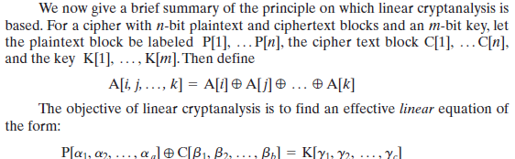
Linear Cryptanalysis
Once a proposed relation is determined, the procedure is to compute the results of the left-hand side of the preceding equation for a large number of plaintext–ciphertext pairs. If the result is 0 more than half the time,

Slide 61
Block Cipher Modes of Operations
To apply a block cipher in a variety of applications, five "modes of operation" have been defined.
The five modes are intended to cover a wide variety of applications of encryption for which a block cipher could be used.
These modes are intended for use with any symmetric block cipher, including triple DES and AES.
Electronic Code Book (ECB)
Cipher Block Chaining (CBC)
Cipher Feedback (CFB)
Output Feedback (OFB)
Counter (CTR)

Slide 62
1. Electronic Code Book (ECB)
In ECB Mode Plaintext handled one block at a time and each block of plaintext is encrypted using the same key.
The term codebook is used because, for a given key, there is a unique ciphertext for every b-bit block of plaintext.

Slide 63
ECB Encryption & Decryption
64-bit
64-bit
K
K
…
K
Encrypt
Encrypt
Encrypt
64-bit
64-bit
C₁
C₂
C_{N}
C₁
C₂
C_{N}
64-bit
64-bit
K
K
…
K
Decrypt
Decrypt
Decrypt
64-bit
64-bit
P₁
P₂
P_{N}

Slide 64
Electronic Code Book ( Continue)
Strength: it’s simple.
Weakness:
Repetitive information contained in the plaintext may show in the ciphertext, if aligned with blocks.
If the message has repetitive elements with a period of repetition a multiple of b bits, then these elements can be identified by the analyst.
Typical application:
Secure transmission of short pieces of information (e.g. a temporary encryption key)

Slide 65
2. Cipher Block Chaining (CBC)
CBC is a technique in which the same plaintext block, if repeated, produces different ciphertext blocks.
In this scheme, the input to the encryption algorithm is the XOR of the current plaintext block and the preceding ciphertext block; the same key is used for each block.
To produce the first block of ciphertext, an initialization vector (IV) is XORed with the first block of plaintext.
On decryption, the IV is XORed with the output of the decryption algorithm to recover the first block of plaintext.

Slide 66
CBC - Encryption & Decryption
IV
C_{N-1}
K
K
…
K
Encrypt
Encrypt
Encrypt
C₁
C₂
C_{N}
C₁
C₂
C_{N}
K
K
…
K
Decrypt
Decrypt
Decrypt
IV
C_{N-1}
P₁
P₂
P_{N}

Slide 67
Cipher Block Chaining (CBC) – Continue…
Strength: because of the chaining mechanism of CBC, it is an appropriate mode for encrypting messages of length greater than b bits
Typical application:
General-purpose block oriented transmission
Authentication

Slide 68
3. Cipher Feedback Mode (CFB)
For AES, DES, or any block cipher, encryption is performed on a block of b bits. In DES, b = 64 and in AES, b = 128.
However, it is possible to convert a block cipher into a stream cipher, using cipher feedback (CFB) mode, output feedback (OFB) mode, and counter (CTR) mode.
A stream cipher eliminates the need to pad a message to be an integral number of blocks.

Slide 69
CFB Encryption
C_{N-1}
IV
Shift register b-s bits | s bits
Shift register b-s bits | s bits
K
K
K
Encrypt
Encrypt
Encrypt
Select s bits
Discard b-s bits
…
Select s bits
Discard b-s bits
Select s bits
Discard b-s bits
S bits
S bits
S bits
P₁
P₂
P_{N}
C₁
C₂
C_{N}
S bits
S bits
S bits

Slide 70
CFB Decryption
C_{N-1}
IV
Shift register b-s bits | s bits
Shift register b-s bits | s bits
K
K
K
Encrypt
Encrypt
Encrypt
Select s bits
Discard b-s bits
…
Select s bits
Discard b-s bits
Select s bits
Discard b-s bits
C₁
C₂
C_{N}
S bits
S bits
S bits
P₁
P₂
P_{N}
S bits
S bits
S bits

Slide 71
CFB Mode
The input to the encryption function is a b-bit shift register that is initially set to some initialization vector (IV).
The leftmost (most significant) s bits of the output of the encryption function are XORed with the first segment of plaintext P1 to produce the first unit of ciphertext C1 , which is then transmitted.
In addition, the contents of the shift register are shifted left by s bits, and C1 is placed in the rightmost (least significant) s bits of the shift register.
For decryption, the same scheme is used, except that the received ciphertext unit is XORed with the output of the encryption function to produce the plaintext unit.

Slide 72
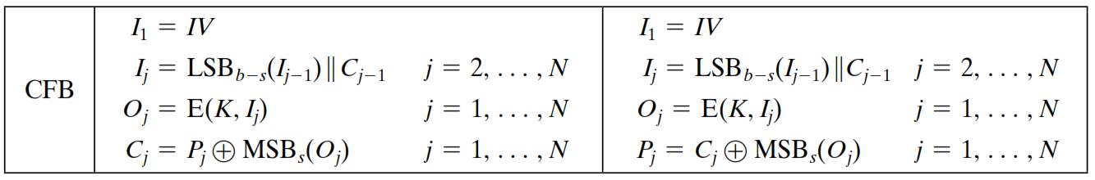
CFB Mode – Cont…

Slide 73
4. Output Feedback Mode (OFB)
The output feedback (OFB) mode is similar in structure to that of CFB.
For OFB, the output of the encryption function is fed back to become the input for encrypting the next block of plaintext.
In CFB, the output of the XOR unit is fed back to become input for encrypting the next block.
The other difference is that the OFB mode operates on full blocks of plaintext and ciphertext, whereas CFB operates on an s-bit subset.
Nonce: A time-varying value that has at most a negligible chance of repeating, for example, a random value that is generated anew for each use, a timestamp, a sequence number, or some combination of these.

Slide 74
OFB Encryption
Nonce
K
K
…
K
Encrypt
Encrypt
Encrypt
P₁
P₂
P_{N}
C₁
C₂
C_{N}

Slide 75
OFB Decryption
Nonce
K
K
…
K
Encrypt
Encrypt
Encrypt
C₁
C₂
C_{N}
P₁
P₂
P_{N}

Slide 76
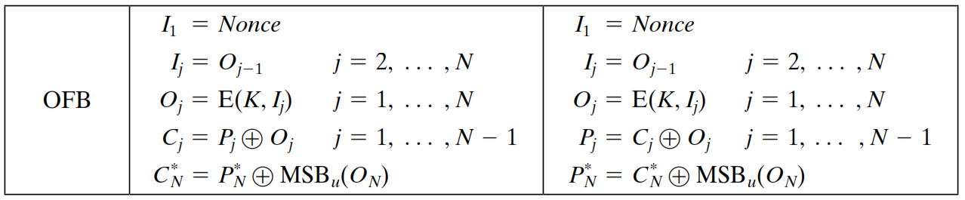
OFB Mode
Each bit in the ciphertext is independent of the previous bit or bits.
This avoids error propagation
Pre-compute of forward cipher is possible

Slide 77
5. Counter Mode (CTR)
Counter (CTR) mode has increased recently with applications to ATM (asynchronous transfer mode) network security and IP sec (IP security).
A counter equal to the plaintext block size is used.
The counter value must be different for each plaintext block that is encrypted.
Typically, the counter is initialized to some value and then incremented by 1 for each subsequent block

Slide 78
CTR Encryption
Counter 1
Counter 2
Counter N
K
K
…
K
Encrypt
Encrypt
Encrypt
P₁
P₂
P_{N}
C₁
C₂
C_{N}

Slide 79
CTR Decryption
Counter 1
Counter 2
Counter N
K
K
…
K
Encrypt
Encrypt
Encrypt
C₁
C₂
C_{N}
P₁
P₂
P_{N}

Slide 80
Advantages of the CTR Mode
Strengths:
Needs only the encryption algorithm
Random access to encrypted data blocks
blocks can be processed (encrypted or decrypted) in parallel
Simple; fast encryption/decryption
Counter must be
Must be unknown and unpredictable
pseudo-randomness in the key stream is a goal

Slide 81
Summary of all modes
Operation Mode | Description | Type of Result
ECB | Each n-bit block is encrypted independently with same key | Block Cipher
CBC | Same as ECB, but each block is XORed with previous cipher text | Block Cipher
CFB | Each s-bit block is XORed with s-bit key which is part of previous cipher text | Stream Cipher
OFB | Same as CFB, but the shift register is updated by the previous s-bit key | Stream Cipher
CTR | Same as OFB, but a counter is used instead of nonce | Stream Cipher

Slide 82
Multiple Encryption
Given the potential vulnerability of DES to a brute-force attack, there has been considerable interest in finding an alternative.
One approach is to design a completely new algorithm, of which AES is a prime example.
Another alternative, which would preserve the existing investment in software and equipment, is to use multiple encryption with DES and multiple keys.

Slide 83
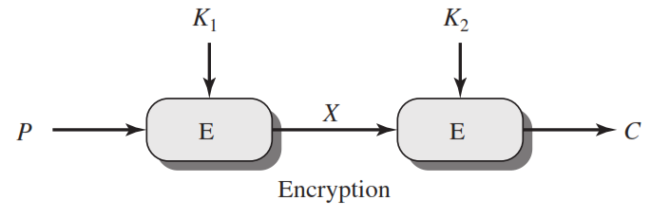
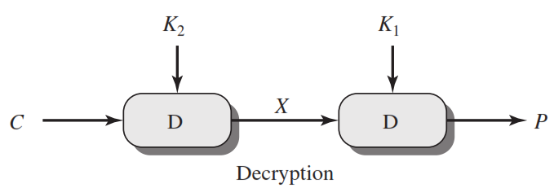
Double DES
C=E(K₂,E(K₁, P))
X = E(K₁, P) = D(K₂, C)
P=D(K₁,D(K₂, C))

Slide 84
Meet in the Middle Attack
This attack involves encryption from one end, decryption from the other and matching the results in the middle.
Suppose cryptanalyst knows P and corresponding C.
Now, the aim is to obtain the values of K1 and K2.

Slide 85
Meet in the Middle Attack Step-1
For all possible values (256) of key K1, the cryptanalyst would encrypt the P by performing E(K1,P).
The cryptanalyst would store output in a table.
Possible Keys
(Key = K1)
00
01
10
11
P
Table of Cipher Text
Encrypt
Cryptanalyst encryption operation

Slide 86
Meet in the Middle Attack Step-2
Cryptanalyst decrypt the known C with all possible values of K2.
In each case cryptanalyst will compare the resulting value with the all values in the table of ciphertext.
Possible Keys
(Key = K2)
00
01
10
11
Table of Cipher Text
C
Decrypt
For each result do a table look up
Cryptanalyst decryption operation

Slide 87
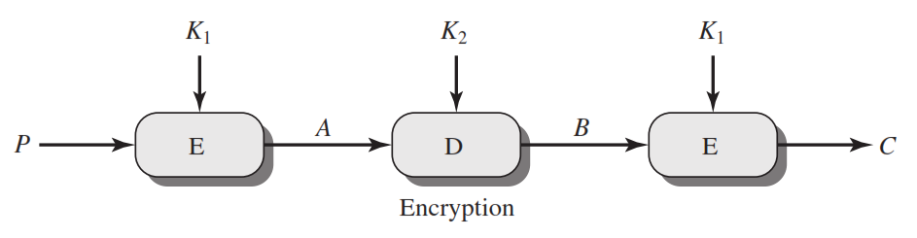
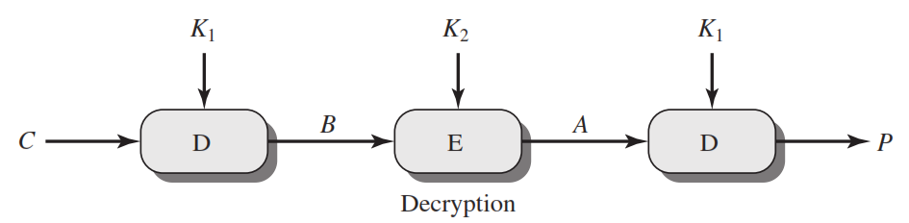
Triple DES
C=E(K₁,D(K₂, E(K₁,P)))
P=D(K₁,E(K₂, D(K₁,C)))

Slide 88
What is RC4 Encryption?
RC4 means Rivest Cipher 4 invented by Ron Rivest in 1987 for RSA Security. It is a Stream Ciphers. Stream Ciphers operate on a stream of data byte by byte. RC4 stream cipher is one of the most widely used stream ciphers because of its simplicity and speed of operation. It is a variable key-size stream cipher with byte-oriented operations. It uses either 64 bit or 128-bit key sizes. It is generally used in applications such as Secure Socket Layer (SSL), Transport Layer Security (TSL), and also used in IEEE 802.11 wireless LAN std.

Slide 89
Why Encryption Is Important?
Unauthorized data access can be prevented by encryption. If we perform encryption then third parties can not have access to data which we share or receive. The encryption is done by using a secret key, or we can say that by using a public key and private key. Both sender and receiver are having their public key and private key through which encryption of plain text and decryption of ciphertext is performed.

Slide 90
Types of RC4
There are various types of RC4 such as Spritz, RC4A, VMPC, and RC4A.
SPRITZ: Spritz can be used to build a cryptographic hash function, a deterministic random bit generator (DRBG), n an encryption algorithm that supports authenticated encryption with associated data (AEAD).
RC4A: Souraduyti Paul and Bart Preneel have proposed an RC4 variant, which they call RC4A, which is stronger than RC4.
VMPC: VMPC is another variant of RC4 which stands for Variably Modified Permutation Composition.
RC4A+: RC4A+ is a modified version of RC4 with a more complex three-phase key schedule which takes about three times as long as RC4 and a more complex output function which performs four additional lookups in the S array for each byte output, taking approximately 1.7 times as long as basic RC4.

Slide 91
Algorithm
The algorithm operates on a user-selected variable-length key(K) of 1 to 256 bytes (8 to 2048 bits), typically between 5 and 16 bytes. To generate a 256-byte state vector S, the master key is used. The first step is the array initialization. It is a character array of size 256 i.e. S[256]. After that, for every element of the array, we initialize S[i] to i.
Code for array initialization: Char S[256]; int i; for(i=0;i<256;i++) S[i] = i The array will look like - S[] = {0, 1, 2, 3, ------, 254, 255}
After this, we will run the KSA algorithm-
KSA is going to use the secret key to scramble this array. KSA is a simple loop, in which we are having two variable i and j. We are using these variables to rearrange the array. Rearranging the array is done by using a secret key.

Slide 92
Algorithm
Code for KSA (Key Scheduling Algorithm ) : int i, j=0; for(i=0;i<256;i++) { j=( j + S[i] + T[i]) mod 256; Swap(S[i], S[j]); }
KSA has been scrambled, S[256] array is used to generate the PRGA(Pseudo Random Generation Algorithm). This is the actual Keystream.
Code for PRGA ( Pseudo Random Generation Algorithm ): i=j=0; while(true) { i = ( i + 1 ) mod 256; j = ( j + S[i] ) mod 256; Swap( S[i], S[j] ); t = ( S[i] + S[j] ) mod 256 ; k = S[t]; }
This is the next step of scrambling.

Slide 93
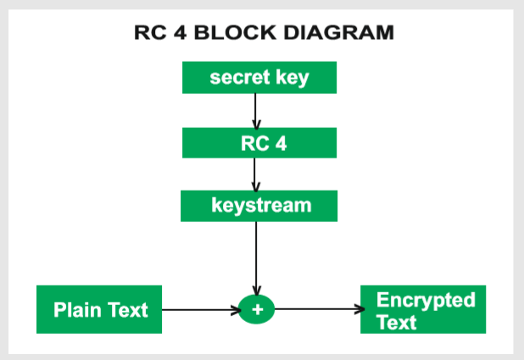
RC4 Block Diagram

Slide 94
Working of RC4
Encryption Procedure:
The user inputs a plain text file and a secret key.
The encryption engine then generates the keystream by using KSA and PRGA Algorithm.
This keystream is now XOR with the plain text, this XORing is done byte by byte to produce the encrypted text.
The encrypted text is then sent to the intended receiver, the intended receiver will then decrypted the text and after decryption, the receiver will get the original plain text.
Decryption Procedure:
Decryption is achieved by doing the same byte-wise X-OR operation on the Ciphertext.
Example: Let A be the plain text and B be the keystream (A xor B) xor B = A

Slide 95
Advantages and Disadvantages
Advantages:
RC4 stream ciphers are simple to use.
The speed of operation in RC4 is fast as compared to other ciphers.
RC4 stream ciphers are strong in coding and easy to implement.
RC4 stream ciphers do not require more memory.
RC4 stream ciphers are implemented on large streams of data.
Disadvantages:
If RC4 is not used with strong MAC then encryption is vulnerable to a bit-flipping attack.
RC4 stream ciphers do not provide authentication.
RC4 algorithm requires additional analysis before including new systems.
RC4 stream ciphers cannot be implemented on small streams of data.
RC4 fails to discard the beginning of output keystream or fails to use non-random or related keys for the algorithm.

Slide 96


www.paruluniversity.ac.in

